Slide 1
Title I Annual Parent Meeting
Fairmount Park Elementary School
Tuesday, September 15, 2020
5:00 PM & 5:45 PM
Virtual Link
LaKisha F. Lawson
Notes:
Welcome!

Slide 2
About Title I
Title I is the largest federal assistance program for our nation’s schools.
The goal of Title I is a higher quality of education for every child. Its purpose is to address the academic needs of students and to assist them in meeting their state’s academic standards.
The program serves millions of children in public elementary and secondary schools each year including eligible students in non-public schools.

Slide 3
Title I Funding
The federal government provides funding to states each year for the Title I program.
The Florida Department of Education sends the funding to our Pinellas County School district.
The school district identifies eligible schools and distributes the Title I funds to the school.
Fairmount Park Elementary School implements a Title I Schoolwide Plan. All students and staff benefit from the supplemental services.
Notes:
The Florida Department of Education receives funds from the federal government. Districts receive Title I funds from Department of Education, and the school district distributes these funds to schools based on the percentage of children eligible for free/reduced price lunch; however, scholars do not have to be from low-income families to receive help.
Our scholars are in a Title I School-wide program. This means that our Title I money can be used to upgrade the educational program in ways that may impact every scholar in the school . This also means that every parent/guardian of a scholar in our school is a Title I parent! The schools set goals for improvement, measure student progress, using standards set forth in the state’s Title I plan, develop programs that add to regular classroom instruction, and involve parents in all aspects of the program.

Slide 4
Title I Programs Provide Supplemental Support
Additional supplemental personnel (i.e Instructional Coaches, Teacher on Deck, Paraprofessional)
Additional training opportunities for school staff (Falcon Summer Institute, content specific training, family engagement, Positive Behavior Intervention Supports)
Extended Learning Opportunities (Promise Time, Math Club, Science Club)
Parent and Family Engagement Resources and Training Workshops
Supplemental teaching materials, equipment, and technology
Notes:
Title I funds are used to supplement the program at our school by providing funds which support:
Additional teachers and paraprofessionals to create smaller classes
Additional training for school staff
Extra time for instruction (Before and/or after school programs)
Parent and Family Engagement Activities
A variety of supplemental teaching methods and materials

Slide 5
Title I Schoolwide Planning
Input from school, family, and community members determine how Title I funds are used based on a needs assessment.
Please attend online or in-person meetings/trainings and complete surveys to provide input on Title I funding.
All Title I schools must document that parents are involved in the schoolwide planning process.
Notes:
Decisions and Planning on How to Use Title I funds based on needs assessment.

Slide 6
Title I Schoolwide Budget
Fairmount Park Elementary School is provided $266,240.00 to pay for supplemental resources and programs for increased student achievement.
Additional classroom support, school-wide supplies, Connect for Success Laptops, Extended Learning Program, Standards-based curriculum.

Slide 7
Title I Parent & Family Engagement Budget
Fairmount Park Elementary School is provided $8,807.00 to pay for supplemental resources and programs for increased student achievement.

Slide 8
Parent’s Right to Know
As a parent of a scholar attending a Pinellas County Public School, you have the right to…
Be provided information on your child’s level of achievement on assessments in English/Language Arts, Writing, Mathematics, and Science.
Request and receive information on the qualifications of your child’s teacher and supplemental personnel working with your child.
Be notified of non-highly qualified or out-of-field teachers at the school.
Be informed if your child is taught by a non-highly qualified teacher for four or more consecutive weeks.
Notes:
Principal’s Attestation provides the number of teachers that are non highly qualified or teaching out of field
Parents Rights under ESEA
Request the qualifications of your child’s teacher
Be notified if your child is taught for more than 4 consecutive weeks by a teacher who is not highly qualified
Request opportunities for regular meetings with staff in order to make suggestions
Participate in decisions relating to the education of your child
Submit a written comment on the school-wide program plan when the school makes the plan available to the district (if you are not satisfied with the plan)

Slide 9
Parent’s Right to Know
Title I law requires that all Title I schools and families work together.
As a Title I parent you have the right to be involved in the development of the following plans and documents for our school:
School Improvement Plan (SIP)
Title I Schoolwide Plan
Parent and Family Engagement Plan (PFEP) for the school and district
School-Parent-Student Compact
You may request and attend virtual or in-person meetings to express your opinions, formulate suggestions and participate, as appropriate, in decisions relating to the education of your children.

Slide 10
Working Together for Student Success
Where are these documents located?
Please review these documents at the Parent Station and the school and district websites. We invite you to attend meetings or complete surveys to share your input…we need and want you to be involved.
Check out our website www.pcsb.org/fairmount-es to view:
School Improvement Plan (SIP)
Title I Schoolwide Plan
School Level Parent and Family Engagement Plan (PFEP)
Parent-School-Student Compact
Pinellas County School’s Parent and Family Engagement Plan at www.pcsb.org/titleone and a summary is written in, “Title I Family & School Partnership Overview”, which is given to all Title I families.
Notes:
Section 1112 of ESEA requires meaningful involvement of parents in the decisions made at the school. Specifically, parents are required to be involved in the development, implementation, review and revisions of the Parent and Family Engagement Plan, School-wide Plan (School Improvement Plan) and the Parent-School Compact. Parents are also required to be involved in the development of district wide policies.
Title I District Parent and Family Engagement Plan communicates how the district involves parents and families and build schools’ and parents’ capacity for strong parent and family engagement and to help their children succeed. Must be reviewed and revised annually with parents.
Title I parents can be involved in reviewing and updating the policy each year

Slide 11
Title I Parent Station
Our school’s Title I Parent Station is located in the front office (Community Liaison area).
You will find a copy of Fairmount Park’s PFEP, the School District’s PFEP, Parent’s Right to Know Memo, Upcoming Events, Compact, and School Improvement Plan (SIP).

Slide 12
Parent-School-Student Compact
Every Title I school has a Compact or Agreement.
The purpose of the compact is to foster student achievement. By signing the Parent-School-Student Compact Fairmount Park Elementary teachers, staff, parents and students agree to work together to share the responsibility of helping students meet or exceed state, district and school academic goals.
The Parent-School-Student Compact is updated every year to include parent, student, teacher, and staff input. Parent, student, teacher and staff comments are welcome at any time during the year.
Please review and sign your child’s Compact.
Our goal is to receive 100% participation!
Notes:
Title I School-Parent-Student Compact outlines how parents, the entire school staff, and scholars will share the responsibility for improved student academic achievement. The compact must be reviewed and revised annually with parents.
Title I parents can be involved in reviewing and updating the school/parent policy each year

Slide 13
Parent and Family Engagement Plan (PFEP)
The PFEP Sections include information about the following:
Parent trainings to increase student achievement
Staff trainings for engaging parents
Communication methods between home and school
Flexible meeting times
Accessibility for parents
Coordinating with other Federal Programs

Slide 14
Parent Advisory Council (PAC)
The District has a Parent and Family Engagement Plan. The summary of the this plan is in the Title I School & Family Partnership Overview.
You may access the full plan at www.pcsb.org/titleone
The Parent Advisory Council (PAC) is responsible for reviewing and revising the District PFEP.
PAC will meet virtually or in-person with the district’s Title I Family Education Coordinator.
PAC meets twice a year, if you are interested in representing our school please notify, Katy Foley.

Slide 15
Accountability
School Report Cards
School Grade and Overview
Population and Enrollment
Assessments – Academic Achievement, Growth, and Population
Assessments – English Language Learners
Graduation and Beyond
Educator Qualifications and Equity
Long-Term Goals and Interim Progress
Accelerated Course Enrollment
Per-Pupil Expenditures
National Data
Available online at https://edudata.fldoe.org/ or Front Office

Slide 16
School Classification
Fairmount Park Elementary School is on the rise! Our scholars have made great gains resulting in our school earning a letter grade of “C” as measured by FLDOE 2019 state assessments. We will continue implementing best practices such as providing scholars with an equitable standards based instruction, Positive Behavior Intervention and Supports, the Connect for Success digital initiative, and the Promise Time Extended Learning opportunity, to assist our scholars with meeting grade level proficiency. This year we will continue Soaring to Success!

Slide 17
Florida Standards
Florida’s academic content standards establish high expectations for all scholars.
Florida Standards identify what your child needs to know and be able to do in all content areas. You may read more information by visiting fldoe.org/academic/standards/.
Also, your child’s teacher will be able to explain the standards for your child’s grade level.
Notes:
All curriculum, instruction and assessments are based on student-centered expectations.

Slide 18
School’s Curriculum
Florida’s Standards form the framework of everything taught at school.
Curriculum- (ELA Modules, Ready Math, Science, iReady curriculum)
English/Language Arts
Mathematics
Writing
Science
Social Emotional Learning (SEL)
C
iculum( ELA Modules, Ready Math,
Notes:
This slide is optional if this will be discussed with classroom teacher
School’s Curriculum
Describe and explain the curriculum (Specific names of texts)

Slide 19
Florida Standards Assessment (FSA)
Fall Assessments-
FLKRS (Florida Kindergarten Readiness Assessment)
i-Ready
NWEA MAP
Spring Assessments- Florida Standards Assessment (FSA)
ELA Gr 3rd-5th
Math Gr 3rd-5th
Science Grs 5th

Slide 20
Florida Benchmark For Excellent Student Thinking Standards (B.E.S.T). You may read more information by visiting, http://www.fldoe.org/standardsreview/
Notes:
All curriculum, instruction and assessments are based on student-centered expectations.

Slide 21
Notes:
Here is the timeline for the implementation for Florida’s BEST Standards.

Slide 22
We need your help! Active Parent Involvement
Share a love of learning
Read to and with your child
Review the Compact throughout the year
Keep Portal info up to date
Volunteer
Participate in giving your input for our SIP, PFEP, and budget
Show interest in your child’s school day
Ask her/him questions
Check homework
Praise their efforts
Encourage good study habits
Communicate with the teachers and other staff
Virtually or in-person attend events

Slide 23
Working Together for Student Success
Please join us virtually…
School Advisory Council/SAC Meeting: Tuesday, September 22nd at 4:30 PM

Slide 24
Additional Resources
Title I Parent & Family Coordinator – Amy Brown
dodgeam@pcsb.org
Learning at Home Family Resources - https://www.pcsb.org/Page/32836
Volunteer in a Pinellas County School - https://www.pcsb.org/Page/459
Mentoring & Tutoring - This Year it's Virtual -https://www.pcsb.org/Page/461
Parent Advocacy – Keosha Simmons simmonskeo@pcsb.org
Parent Academy POWER HOURS Webinars - https://www.pcsb.org/Page/26534
Partnerships - https://www.pcsb.org/Page/418

Slide 25
We appreciate your time!
Please feel free to ask any questions and provide feedback on our Title I Program.

Slide 26
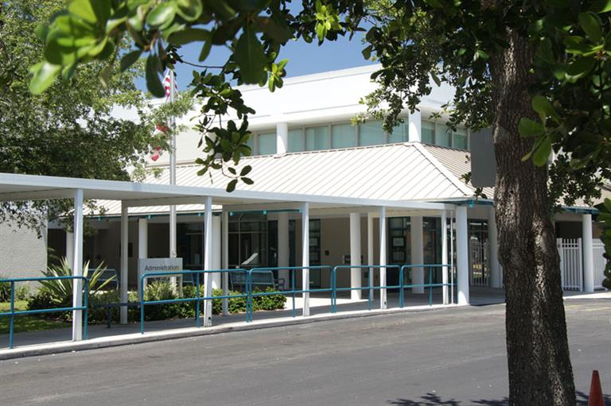
Contact Us
575 41st Street South
St. Petersburg, FL 33711
Phone: (727) 893-2132
Fax: (727) 893-5451
LaKisha F. Lawson
Dominique Clarkson
Notes:
Personalize with all ways you connect with families.

